Slide 2
Safety, early continuation and adherence of same day PrEP initiation among MSM and TGW in Brazil, Mexico and Peru The ImPrEP Study
V. G Veloso; E.H. Vega-Ramírez; B. Hoagland; K. A. Konda; S. Bautista-Arredondo; J. V. Guanira; R. Leyva-Flores; C. Pimenta; M.Benedetti; P. Luz; I. C. Leite; R. I. Moreira; B. Grinsztejn; C. Cáceres, for the ImPrEP Study Team
Share your thoughts on this presentation with #IAS2019
Notes:
Good afternoon.
Thanks very much to the IAS Conference for the opportunity to present the initial results of the imPrEP demonstration project, on behalf of the team and participants.
ImPrEP is an ongoing demonstration project of same day PrEP initiation among MSM and transgender women in Brazil, Mexico and Peru.
In particular, I will be presenting data on safety, early continuation, adherence and HIV incidence. This study is being funded by Unitaid with the support of the Ministries of Health of each country.

Slide 3
Conflict of Interest Disclosure
I have no conflit of interest to disclose.

Slide 4
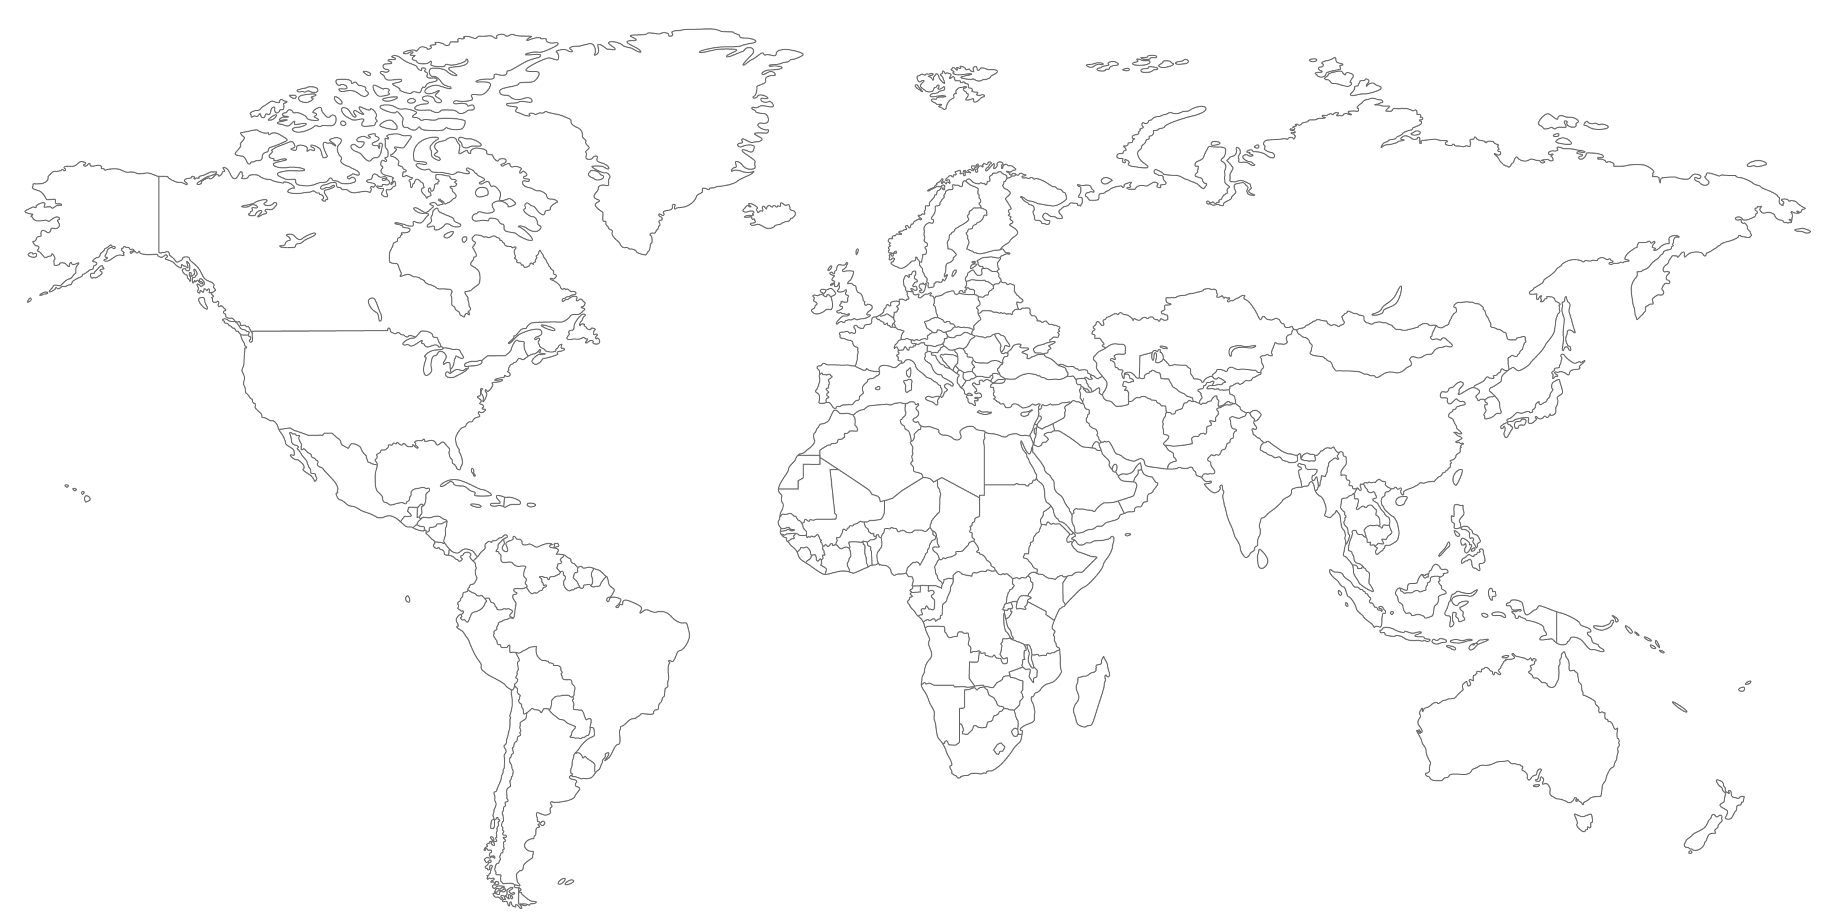
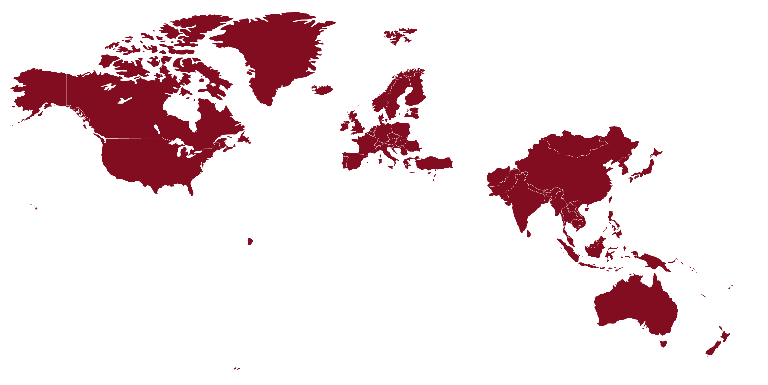
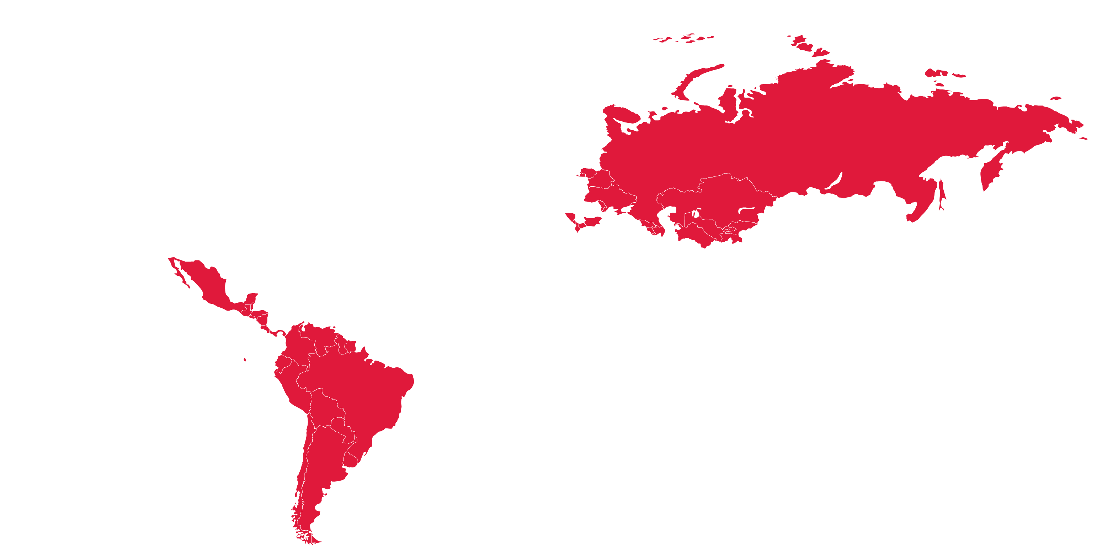
HIV epidemic in Latin America
In 2016,
860,000 people living with HIV.
48,000 new infections per year.
6.1M+
2.1M – 6.1M
1.6M – 2.1M
< 1.6M
No data
UNAIDS Estimates 2017
Notes:
The HIV epidemic in Latin America persists unabated among men who have sex with men (MSM) and transgender women (TGW). PrEP implementation in the region has been very limited. Same day PrEP initiation can increase PrEP uptake where access to services for key populations is scarce.

Slide 5
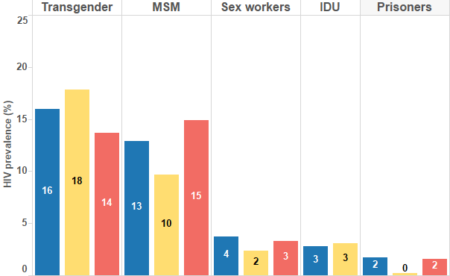
Prevalence of HIV among Key-Populations in Latin America

Slide 6
New HIV infections among adults (15+) in Latin America and the Caribbean by sex, 2010-2016
Caribbean
Latin America
8,500
80,000
8,000
60,000
Females 15+
7,500
Males 15+
# of new infections
# of new infections
40,000
7,000
20,000
6,500
6,000
2010
2011
2012
2013
2014
2015
2016
0
2010
2011
2012
2013
2014
2015
2016
Year
Year
Source: UNAIDS Spectrum estimates, 2017.
Notes:
8% increase in male adults in CAR 2010-2016
2% increase in male adults in LA 2010-2016
Increase grater than 10% 2010-2016 in Chile, Costa Rica, Cuba, Guatemala, Guyana, Honduras, Suriname

Slide 7
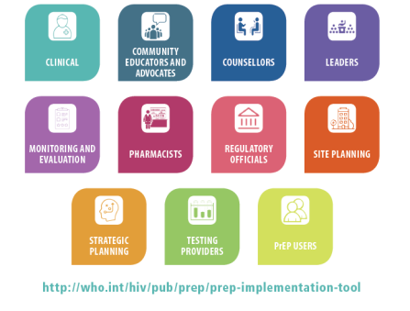
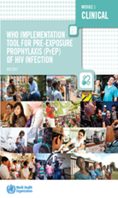
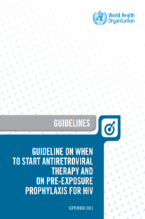
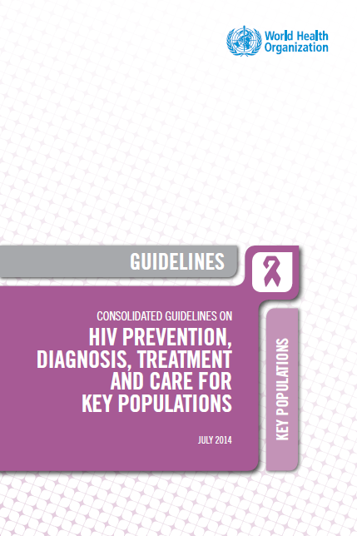
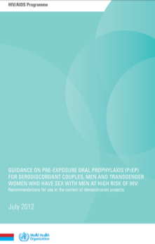
WHO on HIV Pre-exposure prophylaxis (PrEP)
2018
WHO PrEP implementation tool. Update on adolescents and M&E.
2017
PrEP drugs o EML
(TDF/FTC; TDF/3TC; TDF);
WHO PrEP Implementation tool
Global PrEP Coalition
2015
PrEP for people at substantial HIV risk (≈3 per 100 person years) (strong recommendation)
2014
PrEP for MSM
(strong recommendation) Other KP (conditional)
2012
PrEP for SDC, MSM and TG in the context of demo projects (conditional recommendation)
WHO PrEP implementation tool – an enabling document
http://www.who.int/hiv/pub/prep/en/
Notes:
Despite the concentrated epidemic among key populations predominantly MSM and TGW, Pre-exposure prophylaxis (PrEP) implementation in the region has been very limited

Slide 8
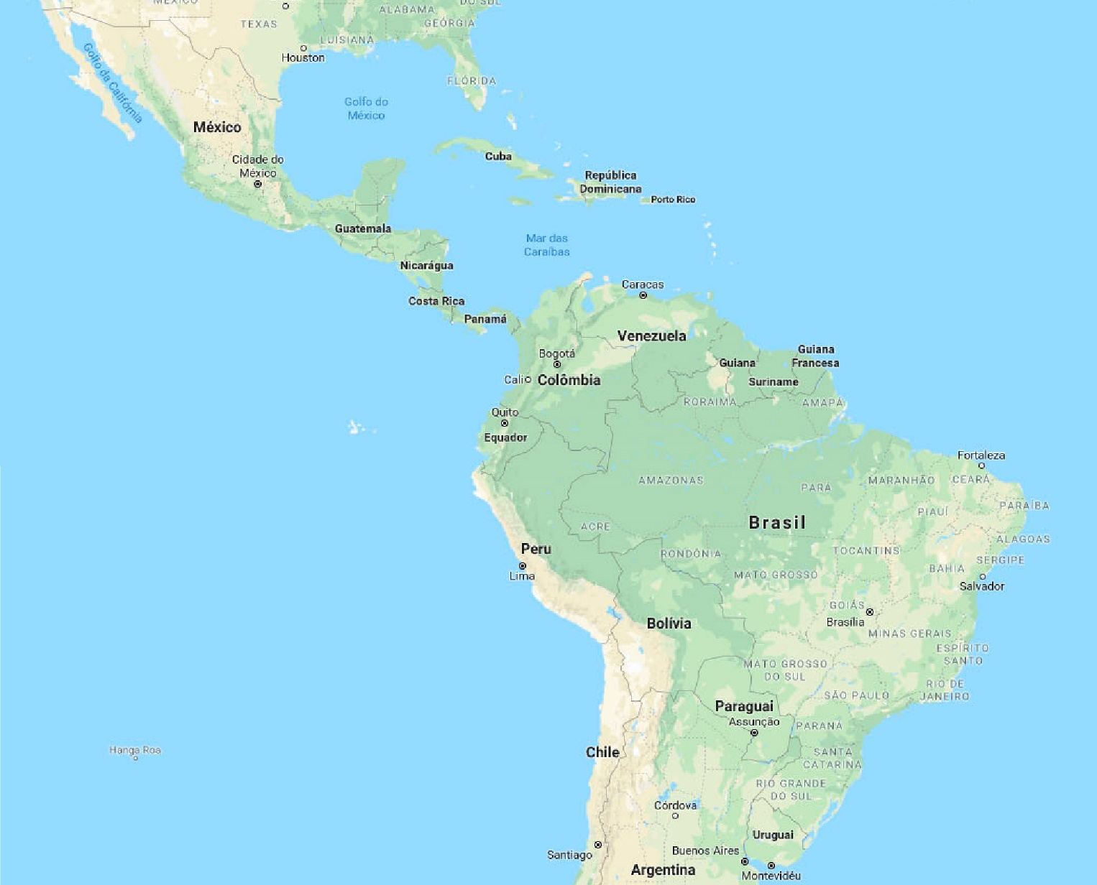
PrEParedness for the Rollout of Effective HIV Prevention among Key Affected Populations in Brazil, Peru and Mexico
Objective: assess uptake, acceptability and feasibility of same day PrEP (TDF/FTC orally once a day) for MSM and TGW in the context of HIV combination prevention.
Design: multi-site prospective, open-label demonstration study.
Countries: Brazil (Fiocruz - Coordination), Peru and Mexico.
Population: 7500 MSM/TGW (Brazil: 3,000; Mexico: 3,000; Peru: 1,500).
Sites: Public Health services and NGOs.
Brazil: 14 sites in 12 cities
Mexico: 6 sites in 3 cities
Peru: 10 sites in 7 cities
Notes:
Eligible participants were HIV uninfected MSM and TGW ≥18 years old at high risk for HIV infection . Participants were screened and enrolled on the same day at 15 sites in Brasil 8 sites in Mexico and 10 sites in Peru and received a 30 days’ supply of TDF/FTC.

Slide 9
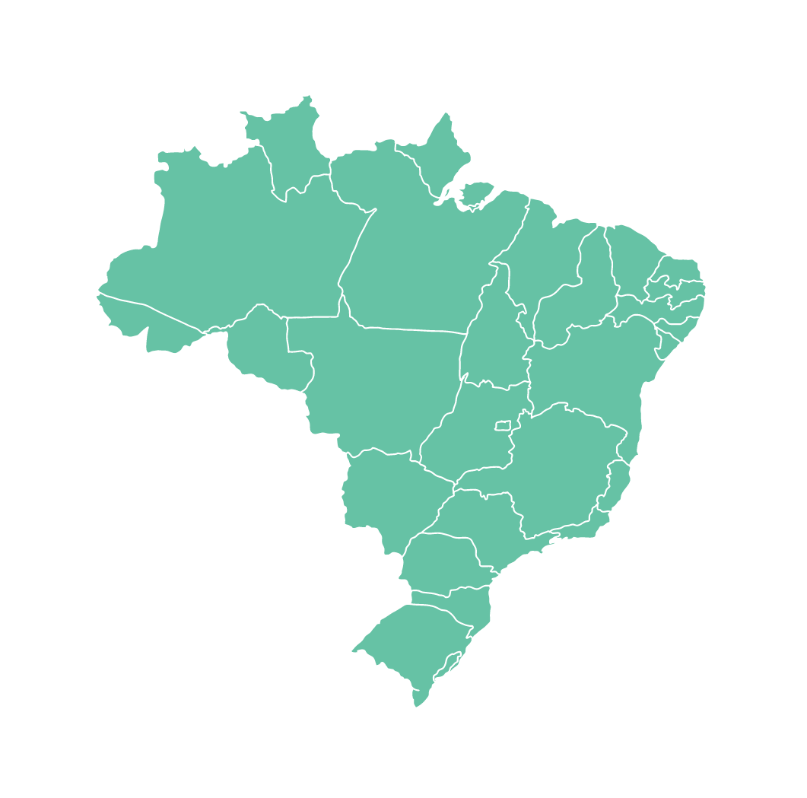
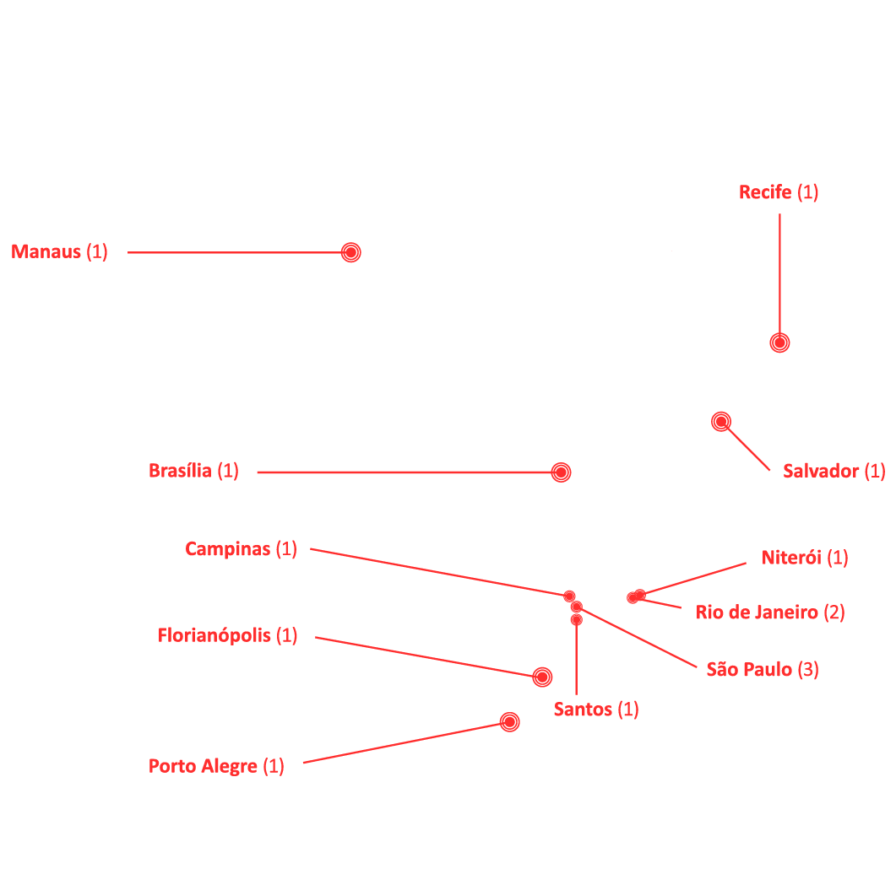
Brazil – 14 sites in 12 cities
Notes:
Eligible participants were HIV uninfected MSM and TGW ≥18 years old at high risk for HIV infection . Participants were screened and enrolled on the same day at 15 sites in Brasil 8 sites in Mexico and 10 sites in Peru and received a 30 days’ supply of TDF/FTC.

Slide 10
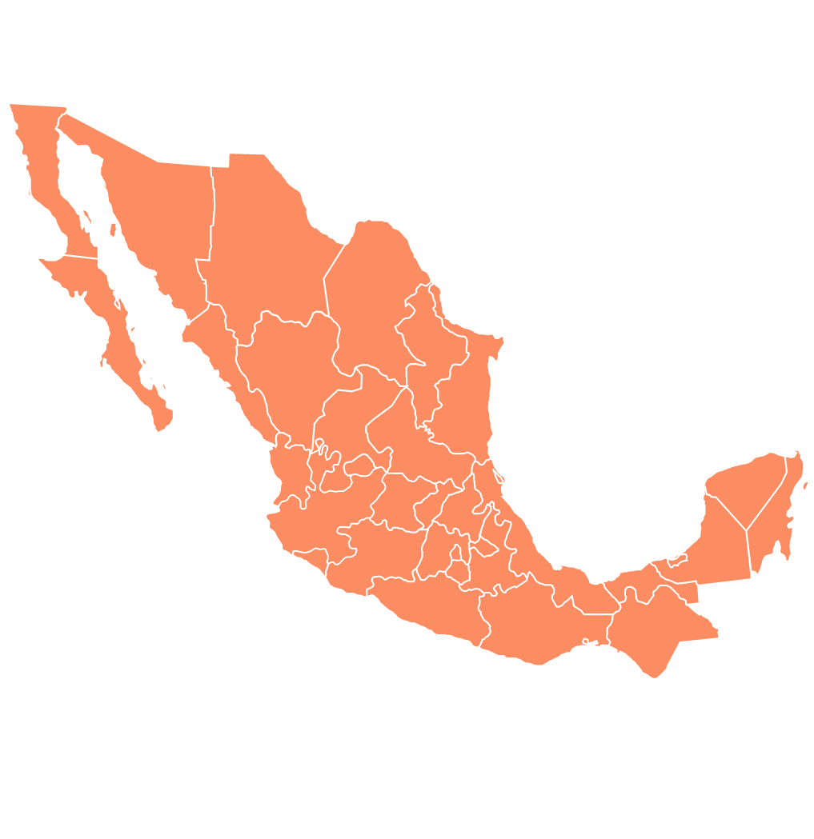
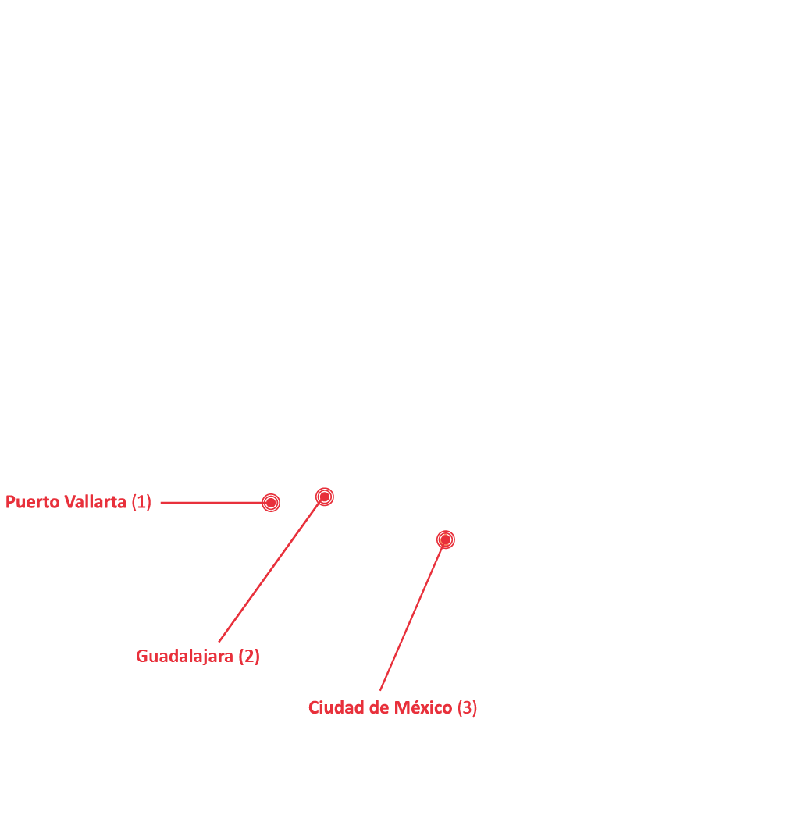
Mexico – 6 sites in 3 cities
Notes:
Eligible participants were HIV uninfected MSM and TGW ≥18 years old at high risk for HIV infection . Participants were screened and enrolled on the same day at 15 sites in Brasil 8 sites in Mexico and 10 sites in Peru and received a 30 days’ supply of TDF/FTC.

Slide 11
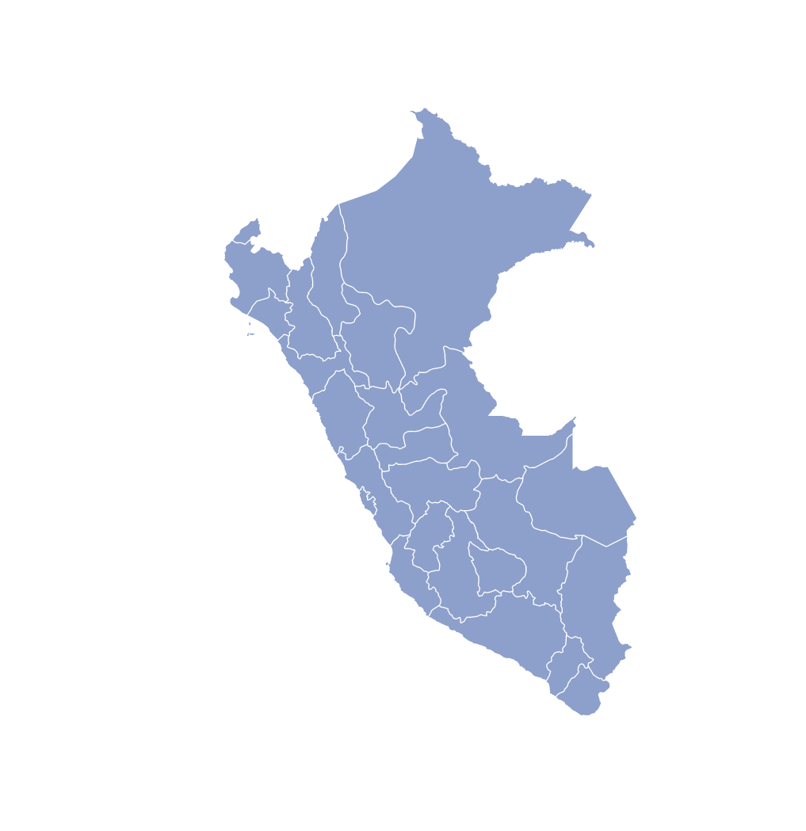
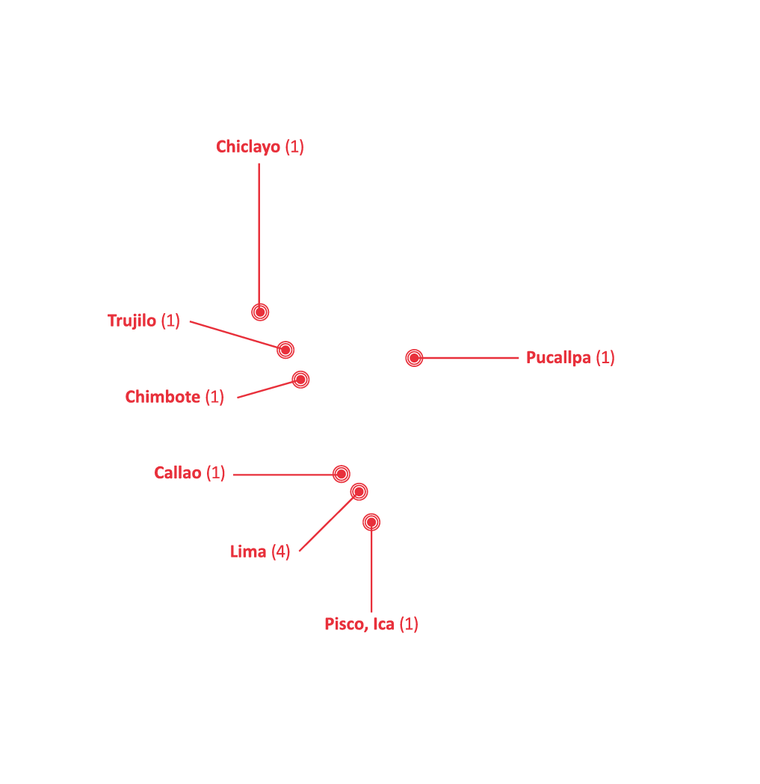
Peru – 10 sites in 7 cities
Notes:
Eligible participants were HIV uninfected MSM and TGW ≥18 years old at high risk for HIV infection . Participants were screened and enrolled on the same day at 15 sites in Brasil 8 sites in Mexico and 10 sites in Peru and received a 30 days’ supply of TDF/FTC.

Slide 12
Study procedures by visit
ENROLLMENT
30 DAYS
QUARTELY
Behaviour assessment
Assessment of Signs and symptoms of HIV acute infection
HIV Rapid Test
HIV Viral load
Renal Function
Syphilis ; hepatitis B and C tests; anal swabs for chlamydia and ghonorhea
30 tablets of TDF / FTC
Adverse events evaluation
Assessment of Signs and symptoms of HIV acute infection
HIV Rapid Test
Behaviour assessment
Adherence self report for the last 30 days
Review of the exams collected at enrollment (except viral load that is reviewed as
DBS collection
90 tablets of TDF / FTC
Adverse events evaluation
Assessment of Signs and symptoms of HIV acute infection
HIV Rapid Test
Behaviour assessment
Adherence Self report for the last 30 days
Syphilis Test
Renal function
DBS collection (twice a year)
90 tablets of TDF / FTC
Notes:
In this slide you can see the study procedures and laboratory assessments at each study visit.
Importantly, participants received a 30 days’ supply of TDF/FTC on the day of enrollment after a negative HIV rapid test result and after signs and symptoms of acute infection were ruled out .
Briefly, on the screening/enrollment visit, a behavior assessment was performed to evaluate Prep eligibility. Additionally, HIV rapid test, Creatinine, hepatitis B, C , syphilis and molecular testing for rectal clamidia and gonorrhea were performed.
A clinical evaluation of signs and symptoms of HIV acute infection and HIV viral load were performed .
A follow up visit was scheduled for 30 day after the initial visit when baseline lab assessments were reviewed. Participants were followed quarterly thereafter.

Slide 13
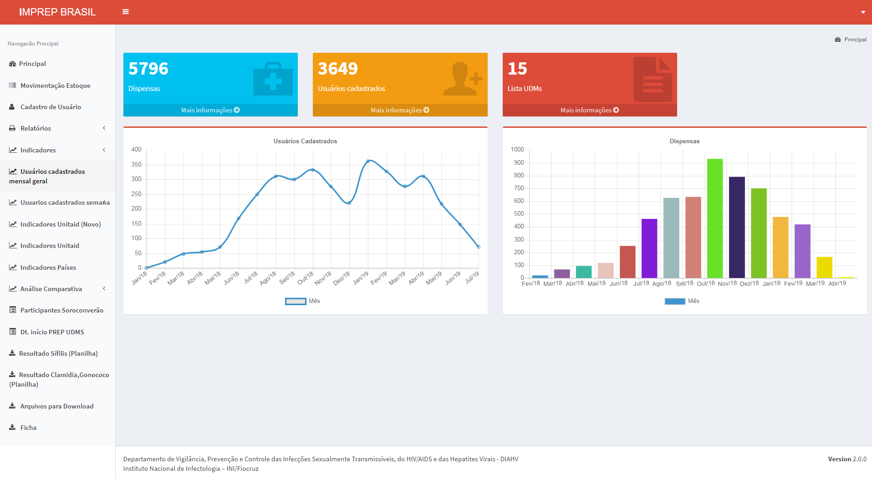
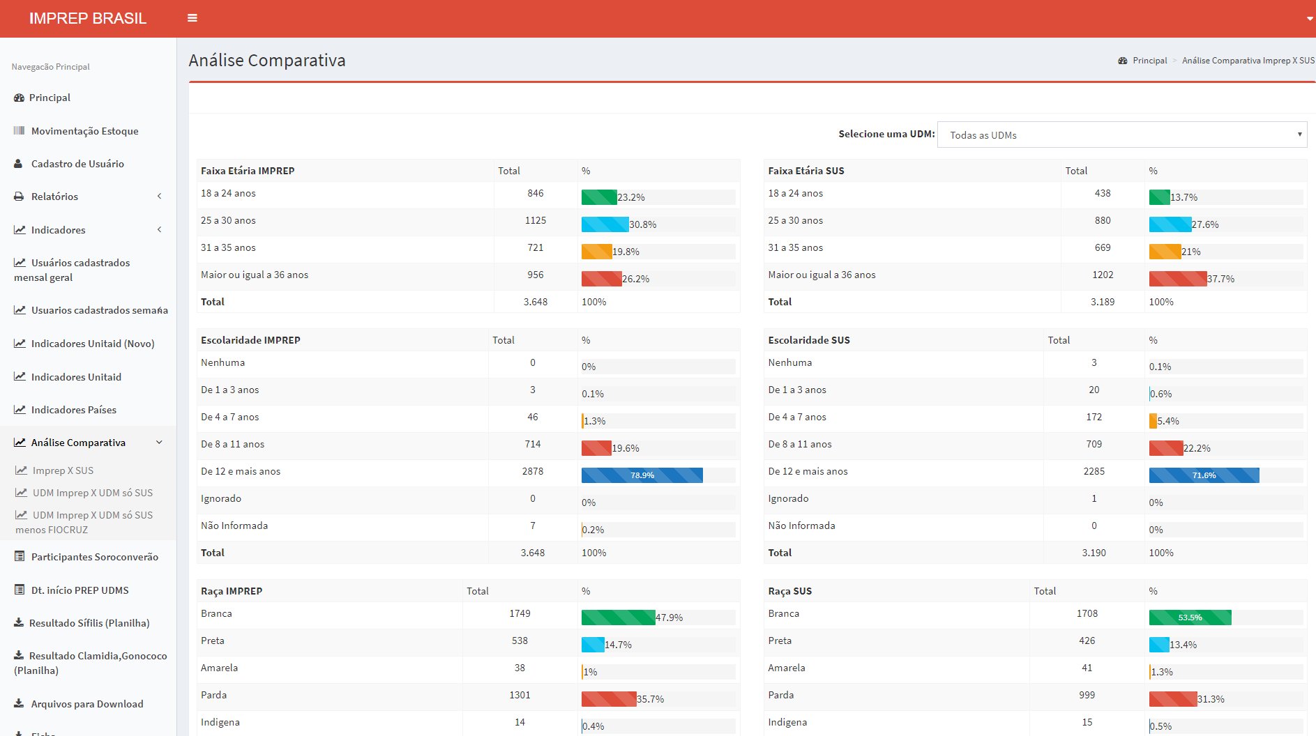
PrEP Monitoring System in SICLOM (ARV logistic system)

Slide 14
Definitions and outcomes
Main outcomes were:
PrEP early continuation defined as attendance to the first 2 follow-up visits within 120 days of PrEP initiation
PrEP adherence, measured using pharmacy refill data defined as having at least 16 days of PrEP medication filled per 30-day period (medication possession ratio ≥0.53).

Slide 15
Sociodemographic Characteristics
 | Brazil | Mexico | Peru | Overall
Age
18 - 24 | 842 (24.29%) | 122 (16.51%) | 418 (36.38%) | 1382 (25.81%)
25 - 34 | 1610 (46.45%) | 397 (53.72%) | 433 (37.68%) | 2440 (45.57%)
35+ | 1014 (29.26%) | 220 (29.77%) | 298 (25.94%) | 1532 (28.61%)
median (IQR) | 29 (25-36) | 30 (26-36) | 27 (23-35) | 29 (24-36)
Educational level
less than secondary/secondary | 722 (20.87%) | 105 (14.21%) | 419 (36.47%) | 1246 (26.30%)
more than secondary | 2738 (79.13%) | 634 (85.79%) | 730 (63.53%) | 4102 (76.70%)
Race
white | 1663 (48.06%) | 119 (16.10%) | 115 (10.01%) | 1897 (35.47%)
non white | 1797 (51.94%) | 620 (83.90%) | 1034 (89.99%) | 3541 (64.53%)
Total enrolled | 3466 | 739 | 1149 | 5354
Notes:
From February 2018 until May 2019, 4954 individuals enrolled in Brazil (3205), Peru (1010) and Mexico (739), accumulating 2069 person-years of PrEP use. Median age was 29 years (IQR 24-36), 94% (4648/4954) were MSM and 6% (306/4954) TGW. Of note, only 44 (1.1%) had an eGFR <60 mL/min.

Slide 16
Sociodemographic Characteristics
 | Brazil | Mexico | Peru | Overall
Gender
MSM | 3309 (95.47%) | 726 (98.24%) | 984 (85.64%) | 5019 (93.74%)
TGW | 157 (4.53%) | 13 (1.76%) | 165 (14.36%) | 335 (6.26%)
Reason to visit the sites
looking for PrEP | 3327 (95.99%) | 711 (96.21%) | 582 (50.65%) | 4620 (86.29%)
others | 139 (4.01%) | 28 (3.79%) | 567 (49.65%) | 734 (13.71%)
eGFR <60 mL/min at enrollment
yes | 29 (0.85%) | 15 (2.54%) | 8 (0.80%) | 52 (1.04%)
no | 3384 (99.15%) | 575 (97.46%) | 987 (99.20%) | 4946 (98.96%)
Total enrolled | 3466 | 739 | 1149 | 5354
Notes:
From February 2018 until May 2019, 4954 individuals enrolled in Brazil (3205), Peru (1010) and Mexico (739), accumulating 2069 person-years of PrEP use. Median age was 29 years (IQR 24-36), 94% (4648/4954) were MSM and 6% (306/4954) TGW. Of note, only 44 (1.1%) had an eGFR <60 mL/min.

Slide 17
Behavioral Characteristics
 | Brazil | Mexico | Peru | Overall
Number of sex partners in last 3 months
median( IQR) | 5 (2-15) | 6 (3-15) | 4 (2-10) | 5 (2-15)
Condomless anal sex
yes | 3121 (90.05%) | 671 (90.80%) | 1086 (94.52%) | 4878 (91.11%)
no | 345 (9.95%) | 68 (9.20%) | 63 (5.48%) | 476 (8.89%)
Sex workers
yes | 341 (9.84%) | 104 (14.07%) | 293 (25.50%) | 738 (13.78%)
no | 3125 (90.16%) | 635 (75.93%) | 856 (74.50%) | 4616 (86.22%)
Total enrolled | 3466 | 739 | 1149 | 5354
Notes:
Baseline active syphilis, rectal chlamydia and rectal gonorrhea prevalence were, respectively, 9.9% (CI 95%:9.0-10.8), 11.7% (CI95%:10.7-12.7) and 7.4% (CI95%:6.6-8.2).

Slide 18
Behavioral Characteristics
 | Brazil | Mexico | Peru | Overall
Condomless sexual intercourse with HIV+ partners
yes | 745 (21.49%) | 243 (32.88%) | 122 (10.62%) | 1110 (20.73%)
no | 780 (22.50%) | 179 (24.22%) | 392 (34.12%) | 1351 (25.23%)
don’t know | 1742 (50.26%) | 301 (40.73%) | 587 (51.09%) | 2630 (49.12%)
NA | 199 (5.74%) | 16 (2.17%) | 48 (4.18%) | 263 (4.61%)
Binge drinking
yes | 2258 (65.15%) | 458 (61.98%) | 857 (74.59%) | 3573 (66.74%)
no | 1208 (34.85%) | 281 (38.02%) | 292 (25.41%) | 1781 (33.26%)
Stimulants
yes | 732 (21.1%) | 401 (54.3%) | 119 (10.4%) | 1252 (23.4%)
no | 2734 (78.9%) | 338 (45.7%) | 1030 (89.6%) | 4102 (76.6%)
Total enrolled | 3466 | 739 | 1149 | 5354
Notes:
Baseline active syphilis, rectal chlamydia and rectal gonorrhea prevalence were, respectively, 9.9% (CI 95%:9.0-10.8), 11.7% (CI95%:10.7-12.7) and 7.4% (CI95%:6.6-8.2).

Slide 19
Sexually Transmitted Infections at enrollment
Overall
MSM
Transgender women
30
20.7
20
17.0
(per 100 participants)
Prevalence
11.5
11.1
12.2
10
10
9.3
7.4
7.0
0
Chlamydia
Ghonorrhea
Syphilis
Chlamydia
Ghonorrhea
Syphilis
Chlamydia
Ghonorrhea
Syphilis
Upper limit
12.4
8.1
10.8
12.1
7.8
10.1
21.3
16.0
25.3
Lower limit
10.6
6.6
9.2
10.2
6.3
8.4
12.7
8.4
16.1

Slide 20
Participants enrolled until 31 December 2018
(Six months window for a first return – 31 June 2019)
 | At least one visit performed after enrollment | No visit perfomed after enrollment
Brazil | 95.2% (1920/2017) | 4.8% (97/2017)
Mexico | 96.6% (677/701) | 3.4% (24/701)
Peru | 84.6% (456/539) | 15.4% (83/539)
Overall | 93.7% (3053/3257) | 6.3% (204/3257)
Notes:
Of individuals initiating PrEP, overall early continuation was achieved by 79,8% while adherence was 96.9%, with differences among participating countries. As you can see in this figures, early continuation in Brasil was 85.5% and adherence was
97.7%. These figures are similar in Mexico, with 82.5% early continuation and 98.4% adherence, and lower in Peru, with 53.6% early continuation and 92.0% adherence. Overall HIV incidence was 0.8 per 100 person years (CI 95% 0.4-1.4), and also varied by country, with higher incidence of HIV infection in Peru.

Slide 21
PrEP early continuation and adherence as measure by the medication possession ratio (MPR) and HIV incidence rate
 | Early continuation | MPR >= 0.53 | Person years (PY) | HIV Incidence per 100 person years (CI 95%)
Brazil | 85.4% | 98.7% | 1438.6 | 0.2 (0.1-0.6)
Mexico | 84.0% | 98.0% | 344.0 | 0.6 (0.2-2.3)
Peru | 52.7% | 91.0% | 286.4 | 2.4 (1.2-5.1)
Overall | 79.6% | 97.2% | 2069.0 | 0.6 (0.3-1.0)
Overall TGW | 55.7% | 88.7%
Overall 18-24 | 70.4% | 95.6%
Notes:
Of individuals initiating PrEP, overall early continuation was achieved by 79,8% while adherence was 96.9%, with differences among participating countries. As you can see in this figures, early continuation in Brasil was 85.5% and adherence was
97.7%. These figures are similar in Mexico, with 82.5% early continuation and 98.4% adherence, and lower in Peru, with 53.6% early continuation and 92.0% adherence. Overall HIV incidence was 0.8 per 100 person years (CI 95% 0.4-1.4), and also varied by country, with higher incidence of HIV infection in Peru.

Slide 22
Conclusions
Our study offers evidence that same day PrEP initiation in Latin America is feasible and safe.
Overall, levels of early continuation and adherence were good.
The lower early continuation and adherence observed among Peruvian participants may be partially explained by the higher vulnerability of the participants enrolled, as well as lower self-referral for PrEP.
Notes:
Our study offers evidence that same day PrEP initiation in Latin America is feasible and safe.
Levels of early continuation and adherence were good.
The lower early continuation and adherence observed among Peruvian participants may be partially explained by the higher vulnerability of the participants enrolled, as well as lower self-referal for PrEP.
Tailored interventions for young individuals and transgender women must be developed.

Slide 23
Conclusions
Tailored interventions for young individuals and transgender women must be developed.
The burden of asymptomatic sexually transmitted infections is high and calls for availability of better STIs diagnosis in the context of PrEP in Latin America.
Notes:
Our study offers evidence that same day PrEP initiation in Latin America is feasible and safe.
Levels of early continuation and adherence were good.
The lower early continuation and adherence observed among Peruvian participants may be partially explained by the higher vulnerability of the participants enrolled, as well as lower self-referal for PrEP.
Tailored interventions for young individuals and transgender women must be developed.

Slide 24
Acknowledgments
Study participants
ImPrEP teams
Unitaid and WHO Technical Teams
Ministry of Health in Brazil, Mexico and Peru

Slide 25
Thank You!

